Slide 1


EXPLORATORY DATA ANALYSIS PROJECT:
G2M INSIGHT FOR CAB INVESTMENT FIRM
KSENIYA KUDZELICH
JUNE 20, 2024

Slide 2

AGENDA
01
PROBLEM STATEMENT
02
APPROACH
03
GENERAL OVERVIEW
04
ANALYSIS OVERVIEW
05
EXPLORATORY DATA ANALYSIS
06
HYPOTHESIS TESTING RESULTS
07
RECOMMENDATIONS

Slide 3

01
PROBLEM STATEMENT

Slide 4




CLIENT:
XYZ is a private firm in US. Due to remarkable growth in the Cab Industry in last few years and multiple key players in the market, it is planning for an investment in Cab industry and as per their Go-to-Market(G2M) strategy they want to understand the market before taking final decision.
OBJECTIVE:
Provide actionable insights to help XYZ firm identify the right company to make their investment.

Slide 5
02
APPROACH

Slide 6
My strategic approach is to meticulously analyze the provided datasets, encompassing transaction details, customer demographics, transaction-to-customer mappings, and city-specific cab usage statistics.
Through this comprehensive analysis and hypothesis testing, I aim to uncover actionable insights and trends within the cab industry.
Hypothesis testing will allow to validate assumptions about the factors influencing profitability and market dynamics, providing a robust statistical foundation for my analysis.

Slide 7
03
GENERAL OVERVIEW

Slide 8

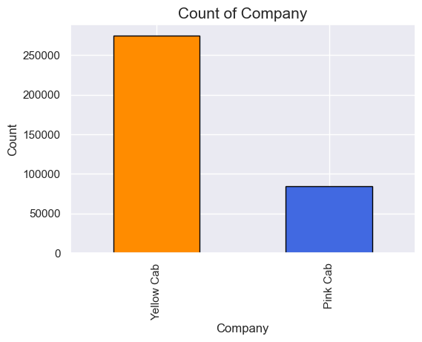
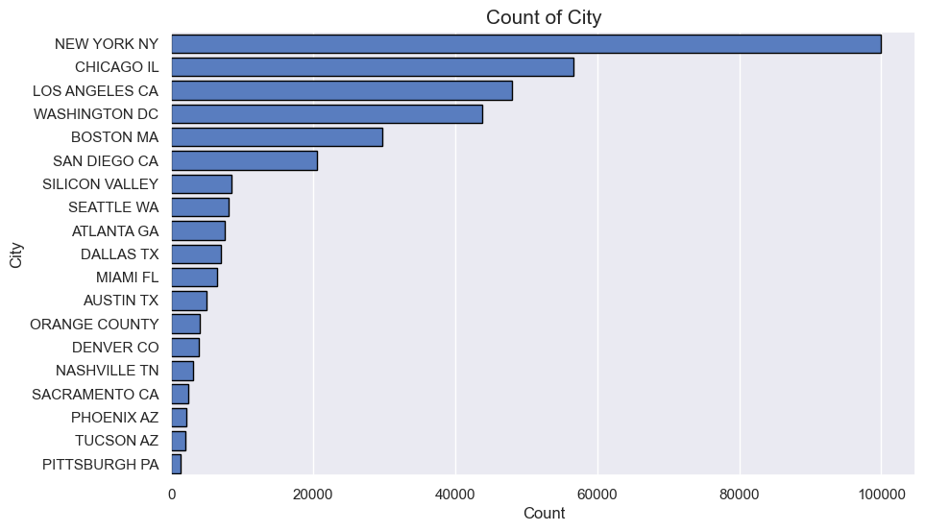
GENERAL OVERVIEW OF CAB DATA
Yellow Cab dominates the market share
New York has the highest number of transactions

Slide 9
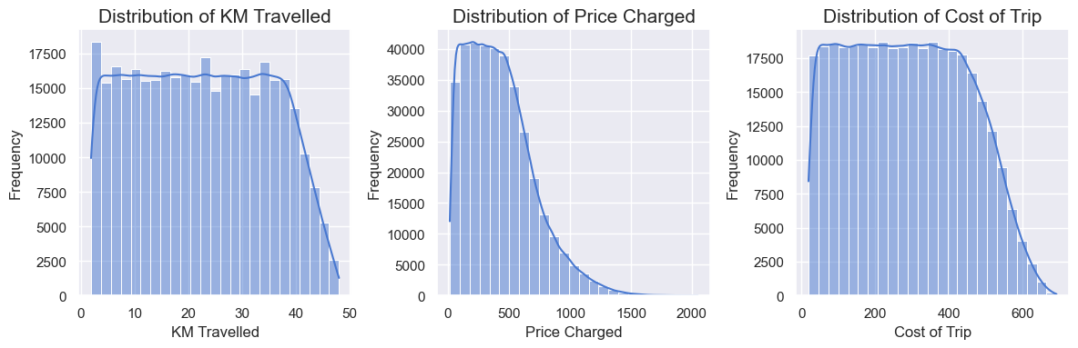
GENERAL OVERVIEW OF CAB DATA
Price Charged and Cost of Trip indicate a consistent pricing model based on KM Travelled
Most of the rides varies from 2 to 48 KM

Slide 10
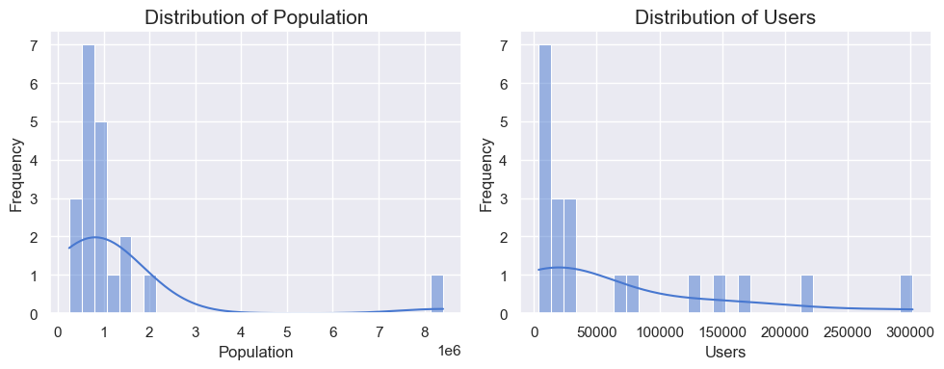
GENERAL OVERVIEW OF CITY DATA
Population and Users show large values in certain cities, likely due to major urban centers

Slide 11

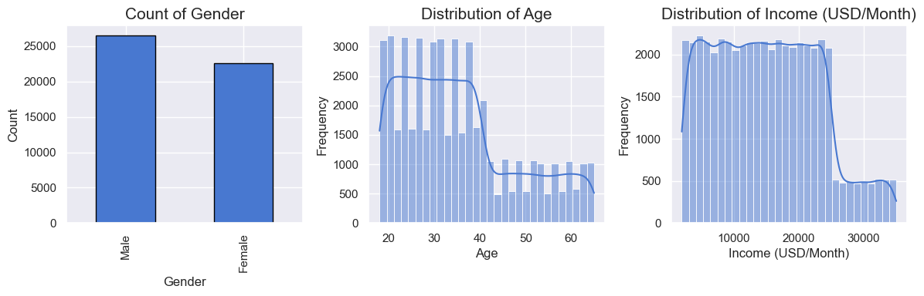
GENERAL OVERVIEW OF CUSTOMER ID DATA
The number of male customers is higher than female customers.
Most customers earn less than $20,000 per month.
Average age - 35 years

Slide 12
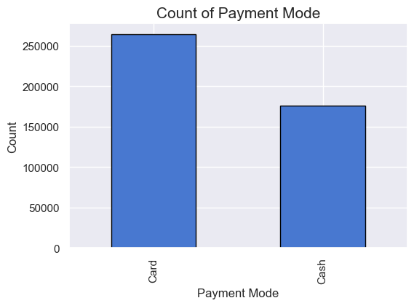

GENERAL OVERVIEW OF TRANSACTION ID DATA
Card payments are more common than cash payments

Slide 13
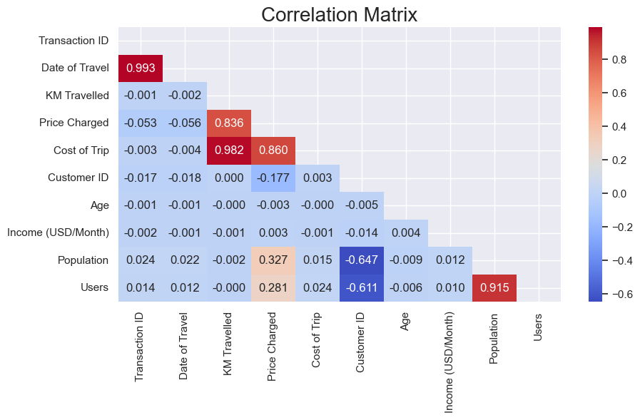
CORRELATION BETWEEN COLUMNS
Strong positive correlation between:
Population - Users
Price Charged - Cost of Trip -
KM Travelled

Slide 14
04
ANALYSIS OVERVIEW

Slide 15

01
02
03
04
OVERALL PERFORMANCE
PROFITABILITY ANALYSIS
CUSTOMER BASE
GEOGRAPHICAL ANALYSIS

Slide 16
05
EXPLORATORY DATA ANALYSIS (EDA)

Slide 17
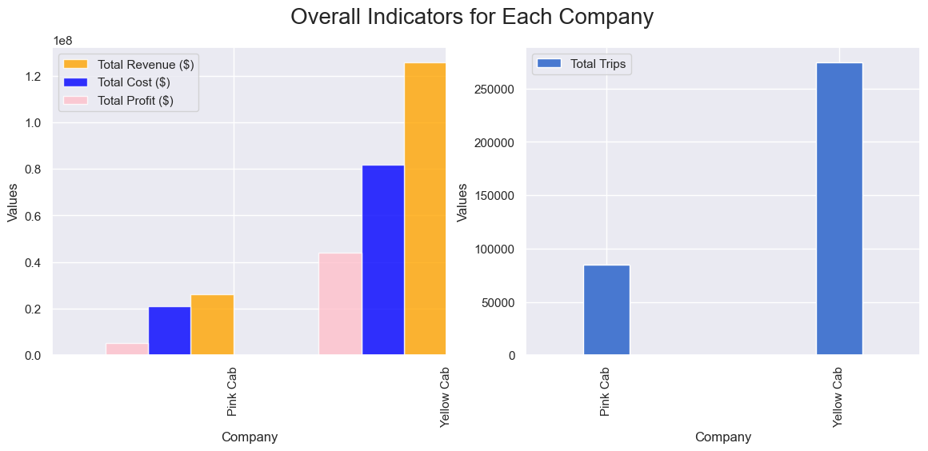
01. OVERALL PERFORMANCE
Yellow Cab is clearly superior to the Pink Cab in all key indicators

Slide 18

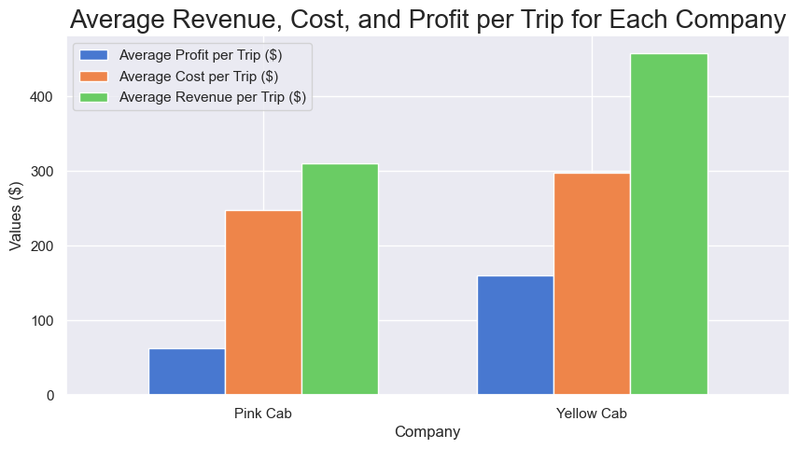
02. AVERAGE REVENUE, COSTS AND PROFIT PER TRIP
All indicators per Trip for Yellow Cab is higher for Pink Cab.

Slide 19
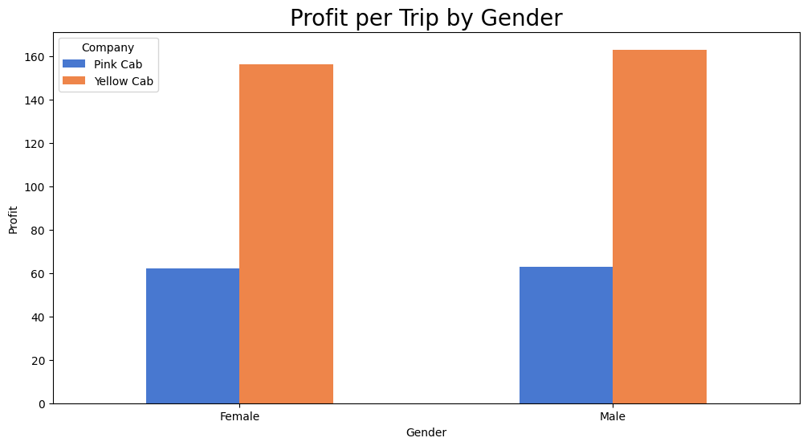
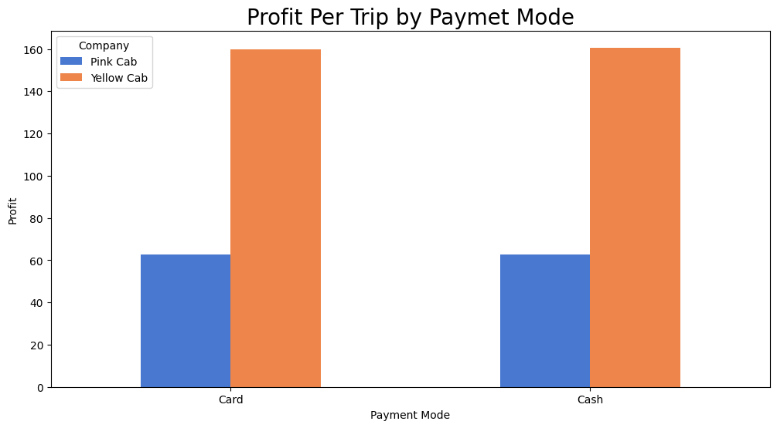
02. PROFIT PER TRIP BY GENDER OR PAYMENT MODE
There is no difference in Profit Per Trip by Gender (hypothesis 1)
There is no difference in Profit Per Trip by Payment Mode (hypothesis 2)

Slide 20
02. AVERAGE REVENUE, COSTS AND PROFIT PER TRIP
The average revenue per trip for Yellow Cab ($458.18) is higher than for Pink Cab ($310.80)
The average cost per trip for Yellow Cab ($297.92) is also higher than for Pink Cab ($248.15)
The average profit per trip for Yellow Cab ($160.26) significantly exceeds Pink's Cab profit ($62.65)
These data indicate that Yellow Cab provides a higher Profit on each trip, despite the higher costs

Slide 21
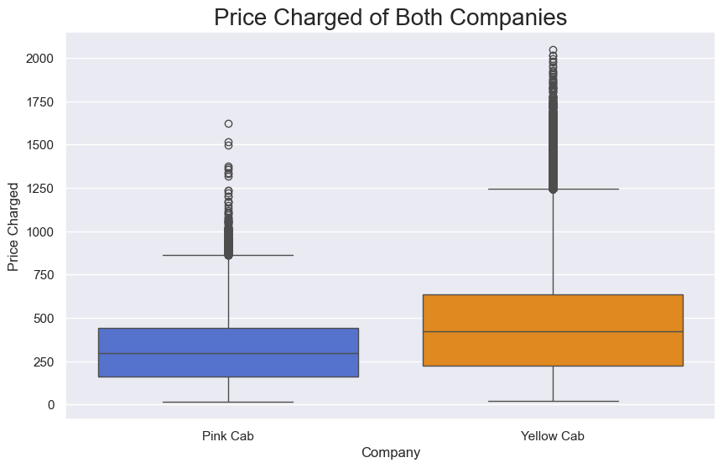
02. PRICES CHARGED BY COMPANY
Prices Charged of Yellow Cab in generall is higher than of Pink Cab (median values $425 vs $298)

Slide 22
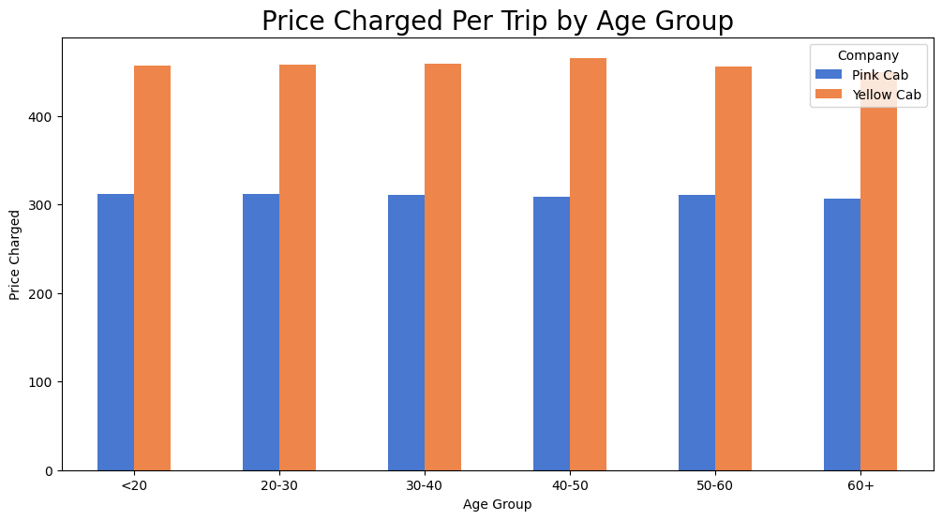
02. PRICE CHARGED PER TRIP BY AGE GROUP
There is no difference between Price Charged Per Trip by Age Group (hypothesis 3)

Slide 23
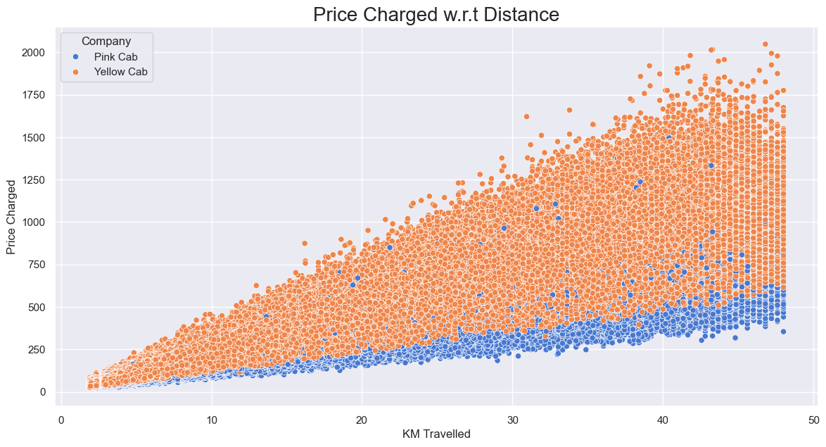
02. PRICE CHARGED VS DISTANCE
There is a linear relationship between KM Traveled and Price Charged
However, Yellow Cab has higher charges compared to Pink Cab

Slide 24
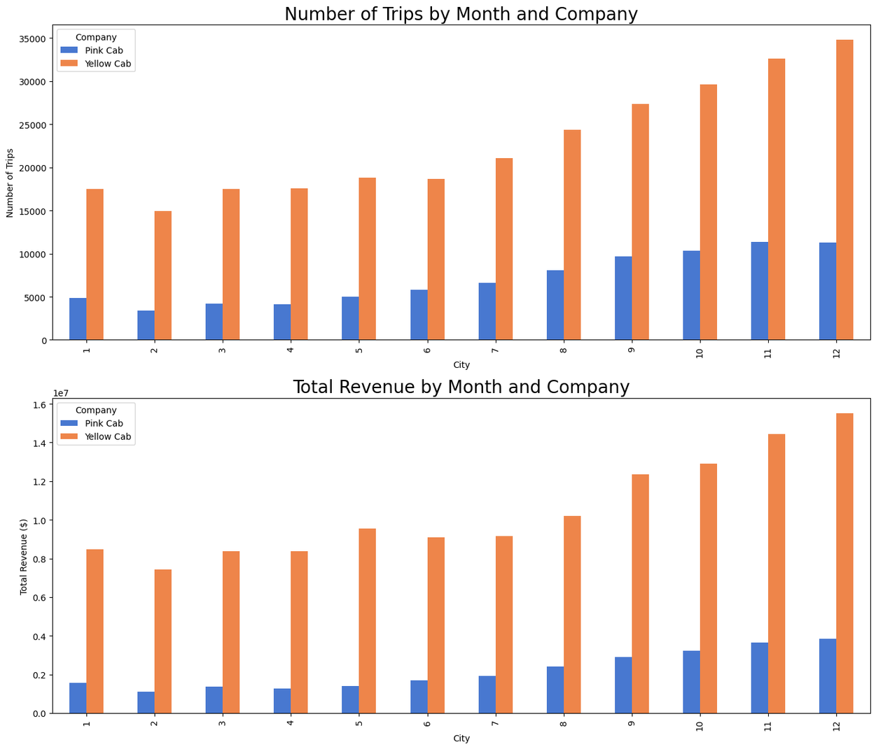
02. SEASONAL TRENDS
Both companies show seasonal fluctuations with certain peaks and troughs at different times of the year.
However, the Yellow Cab shows more stable growth compared to the Pink Cab.
The revenue of both companies also shows seasonal fluctuations.
Yellow Cab has higher revenue indicators during the year.

Slide 25
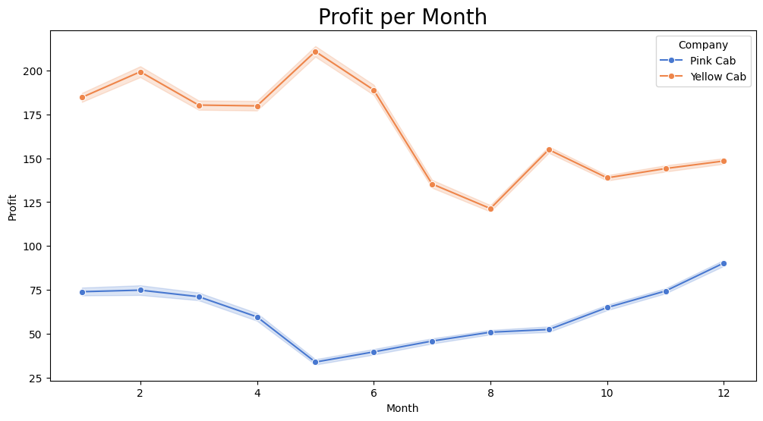
02. PROFIT PER MONTH
The total Profit of Yellow Cab is much more than Pink Cab, which makes sense considering Yellow Cab's market share is about 70%.

Slide 26
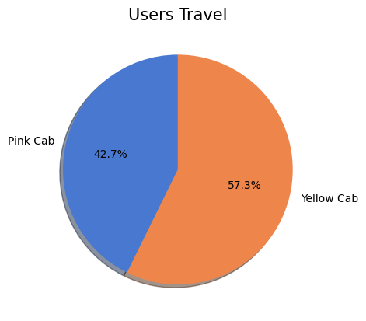
03. USERS TRAVEL
Users are more likely ride by Yellow cab more than by Pink Cab.

Slide 27
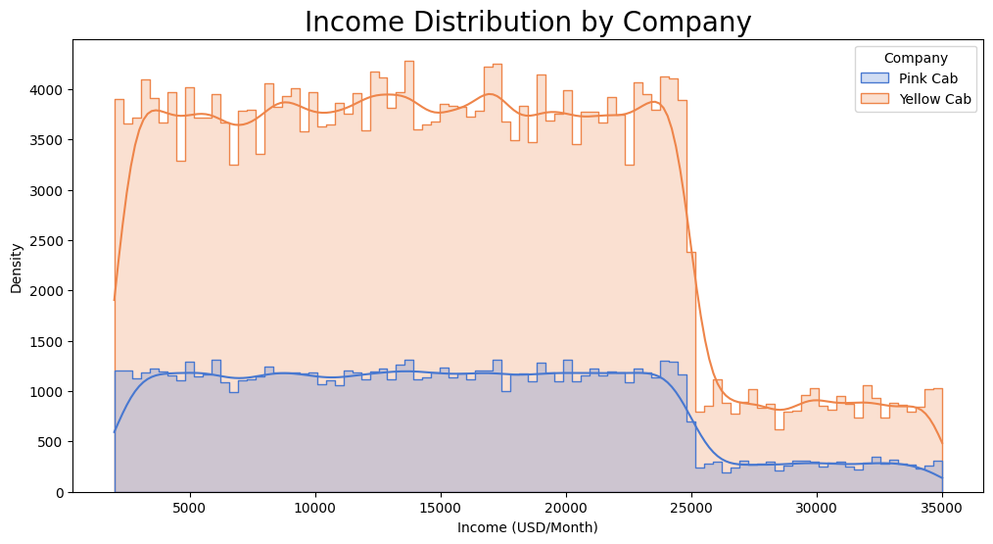
03. CUSTOMER INCOME DISTRIBUTION
The income distribution by company shows that both companies serve customers across a wide range of income levels.

Slide 28
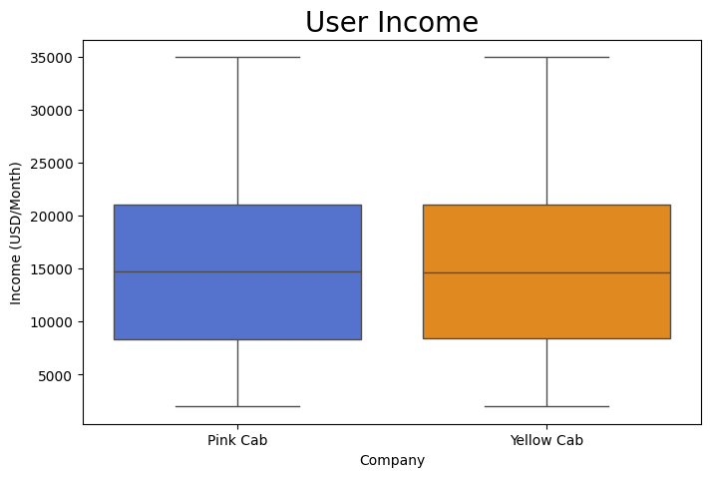
03. AVERAGE INCOME OF CUSTOMERS
The income of the clients of both companies varies widely, but the median income of Yellow Cab (15059.05$) customers is slightly less compared to Pink Cab (15045.66$). (hypothesis 6)

Slide 29
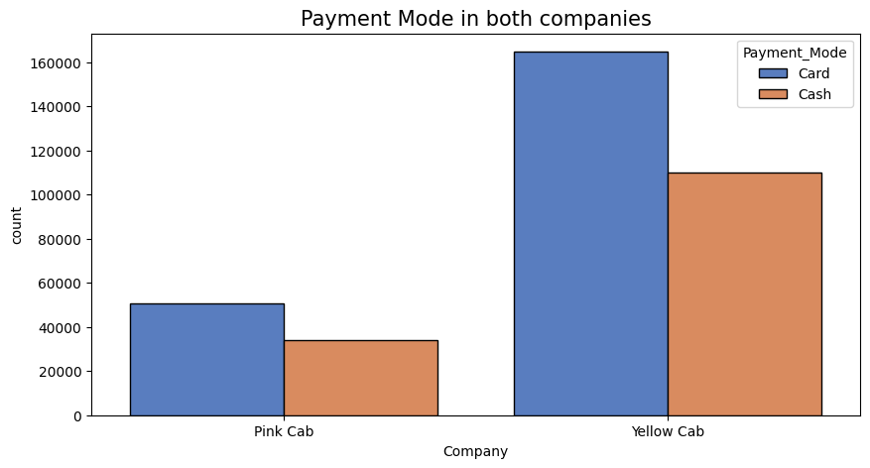
03. PAYMENT MODE
Pink Cab has a more even distribution between cash and cards.
Both payment methods (cash and card) are used in both companies, however, the use of Yellow Cab cards is significantly higher compared to Pink Cab.

Slide 30
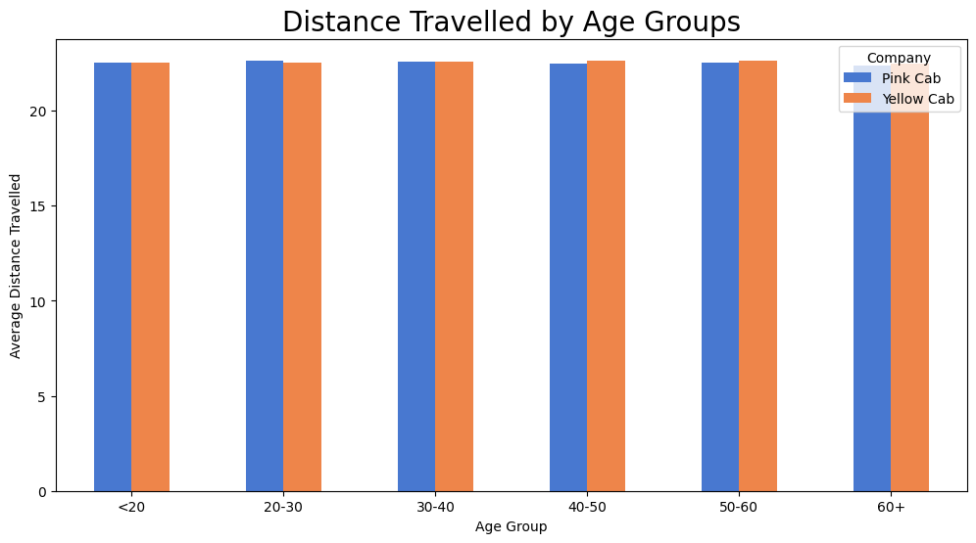
03. DISTANCE TRAVELLED BY AGE GROUPS
There is no diiference in Distance Travelled between Age Groups in companies. (hypothesis 5)

Slide 31
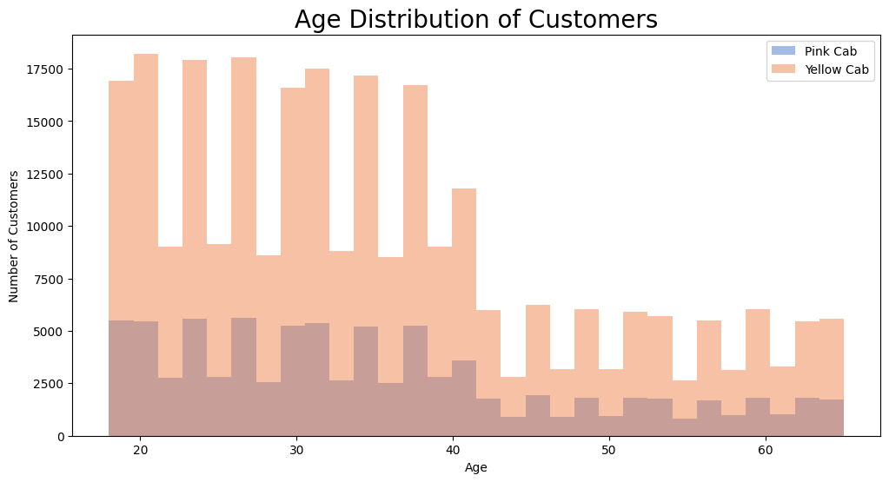
03. AGE DISTRIBUTION
The age groups of clients are similar for both companies.
The majority of clients are between the ages of 20 and 40.

Slide 32
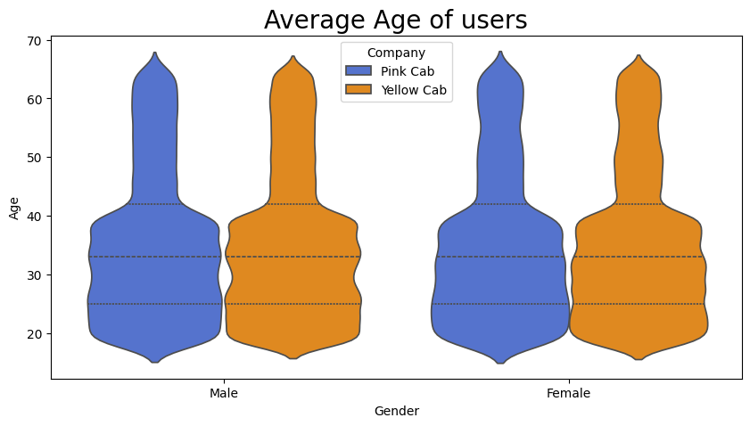
03. AVERAGE AGE OF USERS
35 - is an average Age of Female and Male who use Cab services

Slide 33
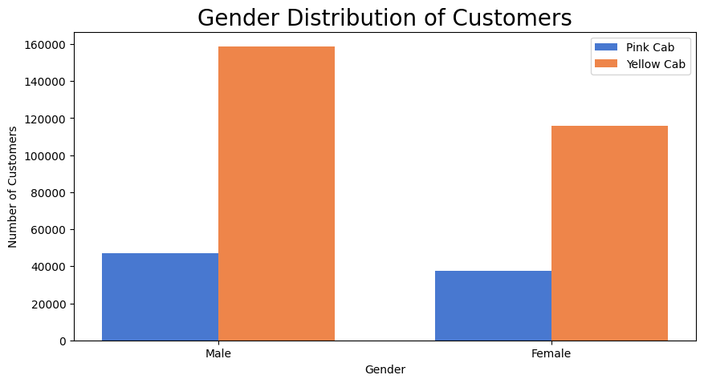
03. GENDER DISTRIBUTION
The ratio of men and women is similar, with a slight predominance of men.

Slide 34
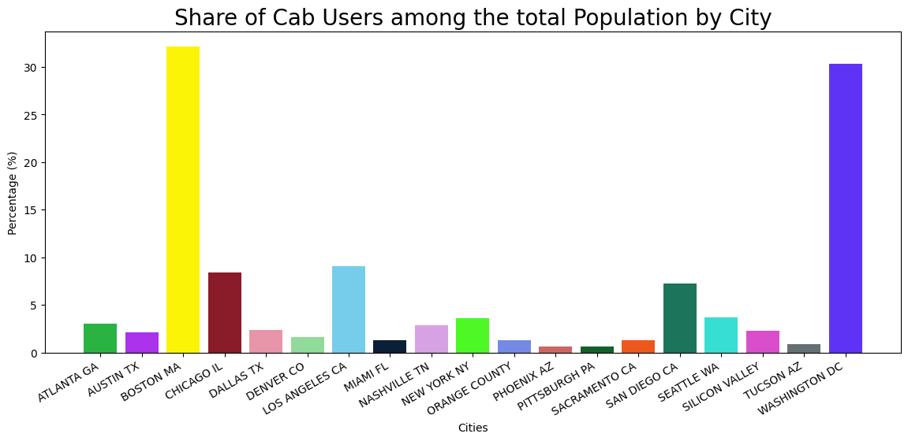
03. SHARE OF CAB USERS AMONG THE TOTAL POPULATION BY CITY
In Washington and Boston more than 30% of population use Cab services

Slide 35
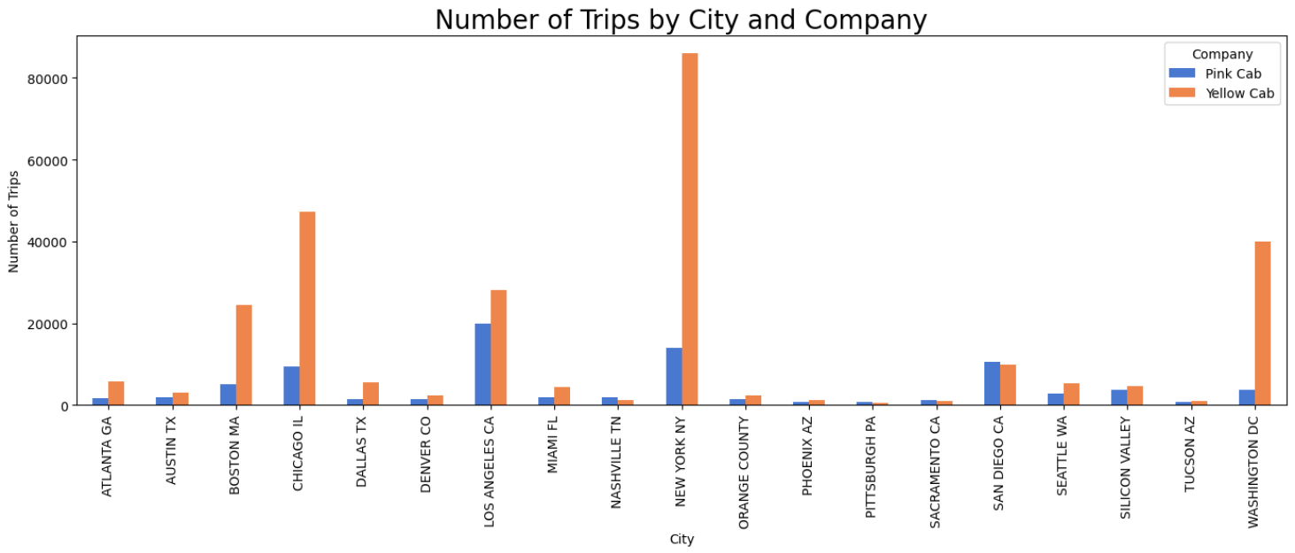
04. NUMBER OF TRIPS BY CITY AND COMPANY
Yellow Cab is the leader in most cities in terms of the number of trips. (hypothesis 4)

Slide 36
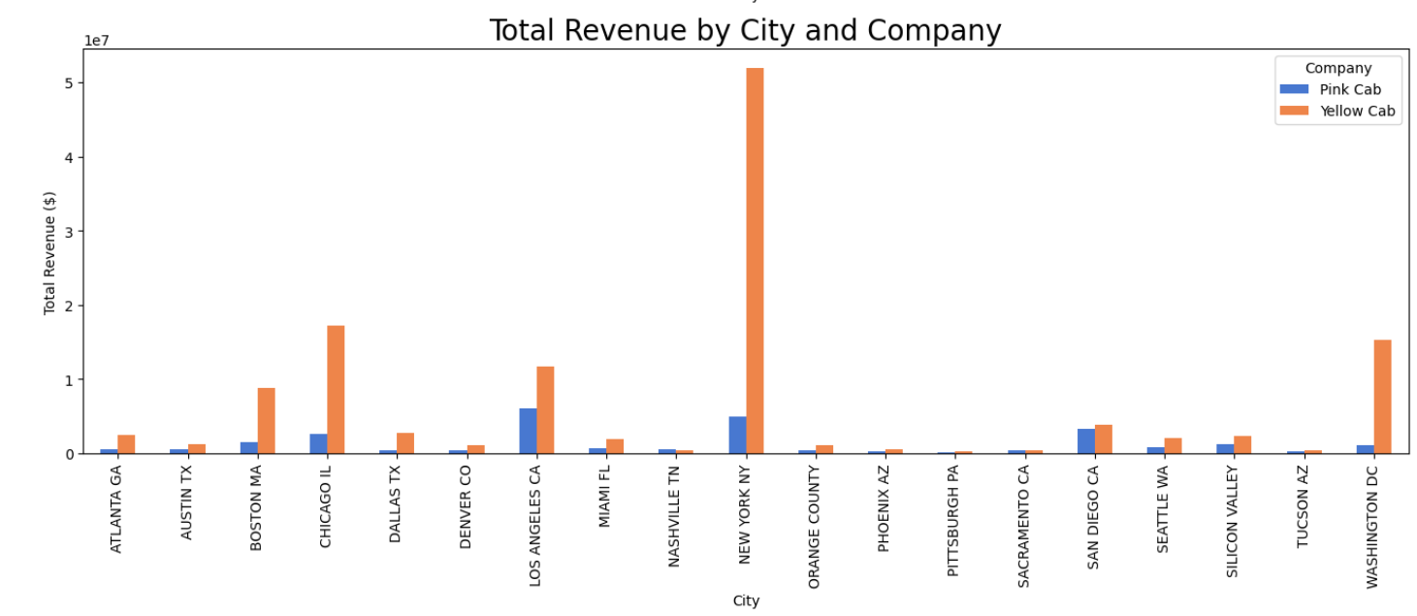
04. TOTAL REVENUE BY CITY AND COMPANY
Yellow Cab also generates more revenue in most cities.

Slide 37
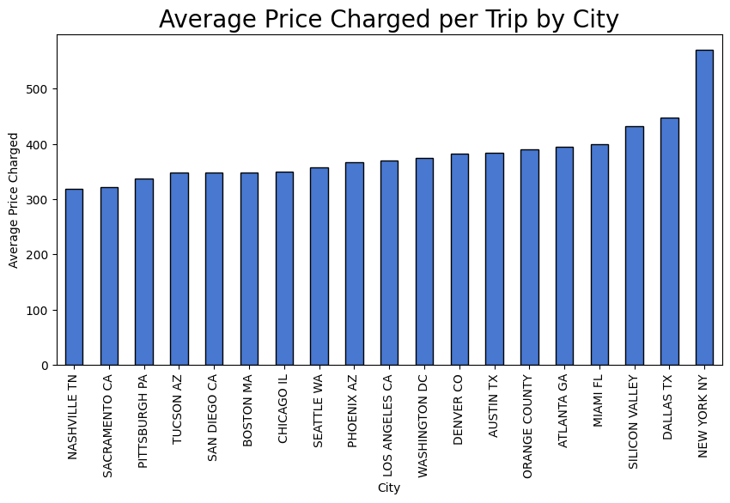
04. AVERAGE PRICE CHARGED PER TRIP BY CITY
There are differences in the average cost of trips between different cities (hypothesis 8).

Slide 38
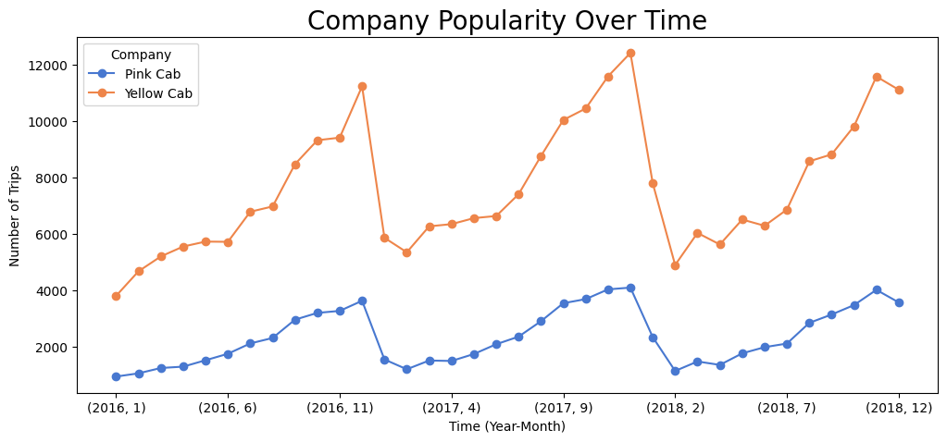
ADDITIONAL INSIGHTS FROM THE DATA:
COMPANY POPULARITY OVER TIME
Yellow Cab generally has a higher number of trips compared to Pink Cab over time.

Slide 39
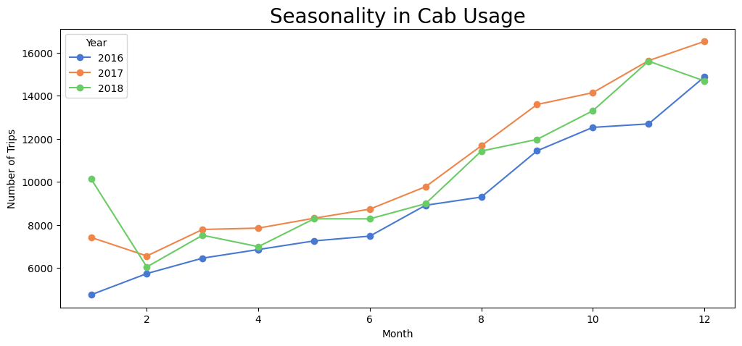
ADDITIONAL INSIGHTS FROM THE DATA:
SEASONALITY IN CAB USAGE
The seasonality analysis shows a clear trend in cab usage over the months. There are noticeable peaks and troughs, indicating that cab usage varies throughout the year.

Slide 40
06
HYPOTHESIS TESTING RESULTS

Slide 41
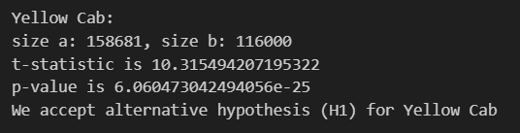
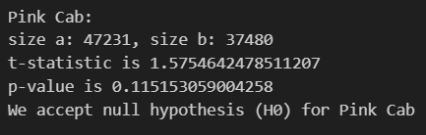
HYPOTHESIS 1:
IS THERE ANY DIFFERENCE IN PROFIT BASED ON GENDER
H0 : There is no difference in profit regarding gender.
H1: There is a difference in profit regarding gender.
Yellow Cab:
There is a difference in profit regarding gender.
Pink Cab:
There is no difference in profit regarding gender.

Slide 42
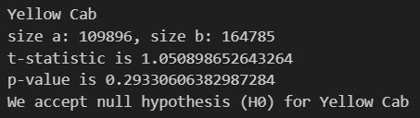
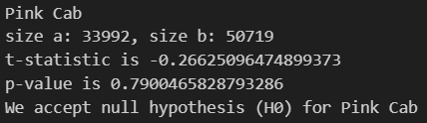
HYPOTHESIS 2:
IS THERE ANY DIFFERENCE IN PROFIT BASED ON PAYMENT MODE
H0 : There is no difference in profit regarding payment mode.
H1: There is a difference in profit regarding payment mode.
Yellow Cab:
There is no difference in profit regarding payment mode.
Pink Cab:
There is no difference in profit regarding payment mode.

Slide 43
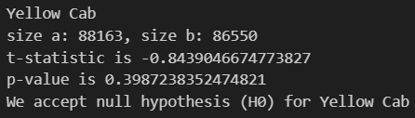
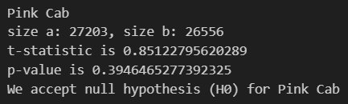
HYPOTHESIS 3:
IS THERE ANY DIFFERENCE IN REVENUE BASED ON AGE GROUP
H0 : There is no difference in revenue regarding age group.
H1: There is a difference in revenue regarding age group.
Yellow Cab:
There is no difference in revenue regarding age group.
Pink Cab:
There is no difference in revenue regarding age group.

Slide 44


HYPOTHESIS 4:
IS THERE ANY DIFFERENCE IN NUMBER OF TRIPS BASED ON CITY
H0 : There is no difference in the number of trips regarding city.
H1: There is a difference in the number of trips regarding city.
Yellow Cab:
There is a difference in the number of trips regarding city.
Pink Cab:
There is a difference in the number of trips regarding city.

Slide 45
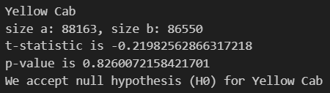
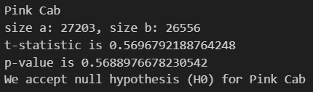
HYPOTHESIS 5:
IS THERE ANY DIFFERENCE IN DISTANCE TRAVELLED BASED ON AGE GROUP
H0 : There is no difference in the distance travelled regarding age group.
H1: There is a difference in the distance travelled regarding age group.
Yellow Cab:
There is no difference in the distance travelled regarding age group.
Pink Cab:
There is no difference in the distance travelled regarding age group.

Slide 46
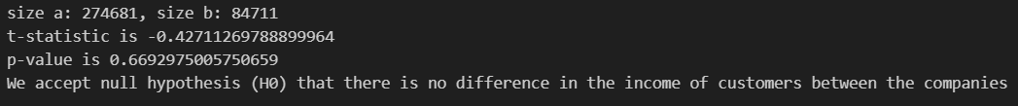
HYPOTHESIS 6:
IS THERE ANY DIFFERENCE IN INCOME OF CUSTOMERS BASED ON COMPANY
H0 : There is no difference in the income of customers regarding the cab company.
H1: There is a difference in the income of customers regarding the cab company.
There is no difference in the income of customers regarding the cab company.

Slide 47
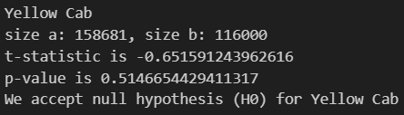
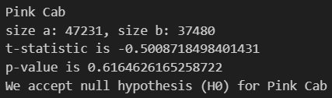
HYPOTHESIS 7:
IS THERE ANY DIFFERENCE IN DISTANCE TRAVELLED BASED ON GENDER
H0 : There is no difference in the distance travelled regarding gender.
H1: There is a difference in the distance travelled regarding gender.
Yellow Cab:
There is no difference in the distance travelled regarding gender.
Pink Cab:
There is no difference in the distance travelled regarding gender.

Slide 48
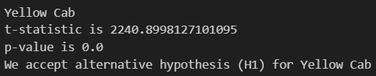
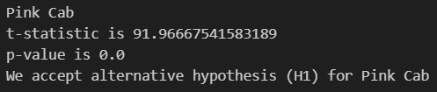
HYPOTHESIS 8:
IS THERE ANY DIFFERENCE IN AVERAGE PRICE CHARGED PER TRIP BY CITY
H0 : There is no difference in Average Price Charged per Trip regarding City.
H1: There is a difference in Average Price Charged per Trip regarding City.
Yellow Cab:
There is a difference in Average Price Charged per Trip regarding City.
Pink Cab:
There is a difference in Average Price Charged per Trip regarding City.

Slide 49
07
RECOMMENDATIONS

Slide 50
BASED ON THE ANALYSIS, THE FOLLOWING CONCLUSIONS CAN BE DRAWN:
1. Overall Company Performance:
Yellow Cab has higher performance in all key parameters:
number of trips (+224.1% more than Pink Cab),
total revenue (+378.1% more than Pink Cab),
total costs (+289.4% more than Pink Cab),
and most importantly, profit (+729.4% more than Pink Cab, or 8.29 times more).

Slide 51
BASED ON THE ANALYSIS, THE FOLLOWING CONCLUSIONS CAN BE DRAWN:
2. Average Performance Per Trip:
Yellow Cab generates more profit per trip, despite higher costs, which makes investments in Yellow Cab more attractive in terms of profitability:
average revenue per trip (+47.4% more than Pink Cab),
average costs per trip (+20.0% more than Pink Cab),
average profit per trip (+155.8% more than Pink Cab, or 2.5 times more).

Slide 52
BASED ON THE ANALYSIS, THE FOLLOWING CONCLUSIONS CAN BE DRAWN:
3. Customer Base:
4. Geographical Distribution:
Both companies have a similar distribution by age and gender of customers, however, Yellow Cab customers have a slightly lower median income (-0.09% or 14$).
Yellow Cab leads in most cities in terms of number of trips and revenue, which shows wider market coverage and potential for further growth.
5. Seasonal Trends:
Both companies show seasonal fluctuations, but Yellow Cab shows more stable growth.

Slide 53
BASED ON THE ABOVE CONCLUSIONS, INVESTING IN YELLOW CAB SEEMS TO BE A MORE REASONABLE AND PROMISING DECISION COMPARED TO PINK CAB.

Slide 54
THANK YOU!

